Slide 1

Internship

Slide 2
NAME: HARSHWARDHAN WAGHELA
ENROLL: 180170117061
BE: Sem – 8TH
DEPARTMENT: INSTRUMENTATION AND CONTROL ENGINEERING
PPT: Orphanage Management (By using Odoo)
COMPANY: Aktive Software .Pvt
INDUSTRIAL MENTOR: Alpesh Savaliya
FACULTY MENTOR: Prof. Kamakshi Kaul
HEAD OF DEPARTMENT: Dr. Mehul Shah

Slide 3
About Company
Aktiv Software was est. in 2015 as a business software development organization. Since then, we have been offering various business management solutions that supports and automates the business processes of our customers and partners. Mainly we cater ERP (Odoo, MS Dynamics) and e-commerce (Magento) solutions while helping you choose the best-suited software for your business requirement.
Mission:
We strive to simplify the business needs by suggesting the best suited options, keeping ease of use at the core and utmost convenience through software enhancements.
Vision:
To be the service provider of choice for organizations, by helping them achieve their digitalization goals.

Slide 4
Internship Training

Slide 5
python training
Types of Python version
Python Keywords
String Formatting with Format Specifiers.
Operators and Expressions
Python Data Types and Control Flow
Loops with Control Flow
Function ,Global, Local and Non-Local
Decorators and Recursive Function
Generic Built -in Function and Data Structures
OOPS , Datetime Library and OS Library

Slide 6
ODOO TRAINING
Odoo Introduction
Odoo Installation, Configuration and OCA guidelines
Quick major apps features walk through on runbot and Git Command
Module structure, Field relations, Inheritance, View structure, Odoo magic fields
Different widgets; many2many_tags(with color index), progress-bar, radio, selection etc.
model and view inheritance, different positions: inside, before, attributes etc. and hasclass[()]
Different mixins to display chatter area and followers .
ORM Methods and domain operators

Slide 7
Method Overloading, Overriding, Inheritance, overwriting.
button type: action and object, Smart buttons with fa-icons.
API Decorators (Onchange, depends, models etc..) and Wizard.
Res Config Settings, System Parameters, set_param, get_param, set_values, get_values.
Special Operators that are used to create/update one2many.many2many records and Advance actions
Functional workflow : Apps mainly covered in the session are CRM, Sales, Invoice and Sales to Delivery flow
QWeb Reports and Excel reports
Schedulers and mail template, mail compose wizard, attach report in mail template
Security, groups and record rules
Code tracing skills (pdb & loggers)

Slide 8
PostgreSQL database, pgadmin and basic database queries SQL and User defined constraints pg_dump, pg_restore, psql for DB backup and restore.
Basics to start for front-end: HTML - Element - Tag - attribute - form CSS - Ways of adding CSS - Basics (Font, Colors, Padding, Margin ...) - Bootstrap - Advanced (Flex, Display, Position, Responsive / Media query, Animation)
Functional workflow : Apps mainly covered in the session are Purchase, Vendor Bills, Receipts etc.

Slide 9
Project (ORPHANAGE MANAGEMENT)

Slide 10
HOW DOES THE MODULE WILL WORK,
At First, we have taken some data of Orphanage which are Management by some NGO’s.
By taking this data we have make management system to manage the expenses like,
1. Foods bills
2. Petrol bills
3. Travelling bills
4. Maintenance etc.
Ours System can also management details of children's, Senior Citizens or Members Details like,
1. Weight and Height
2. Health
3. Diseases etc.

Slide 11
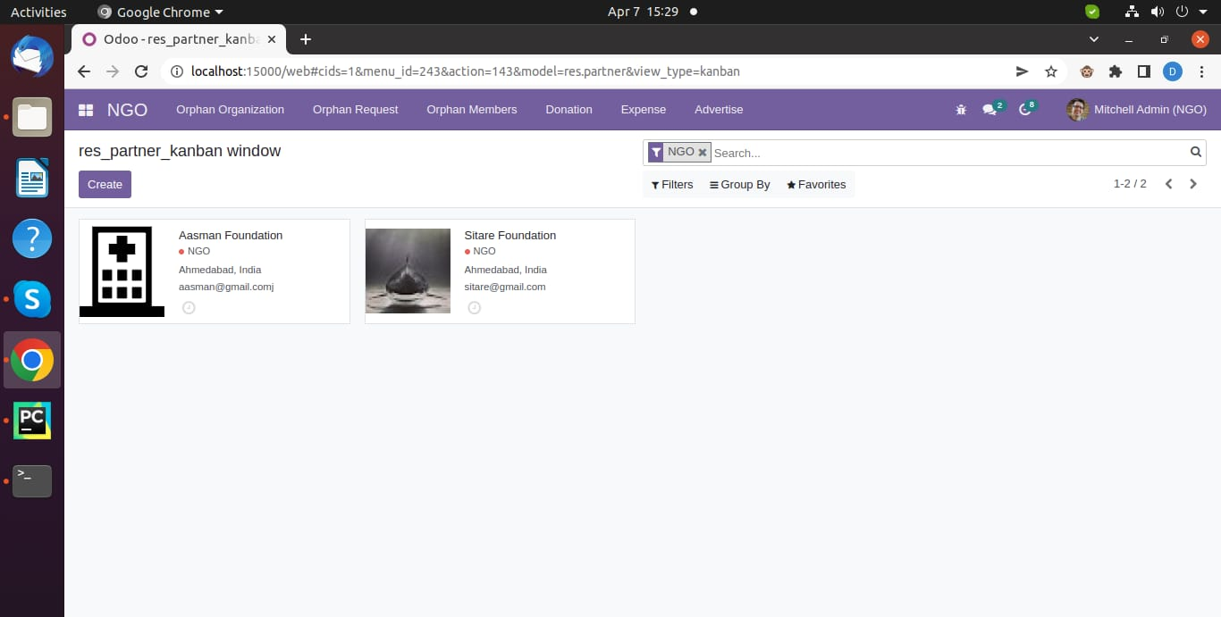
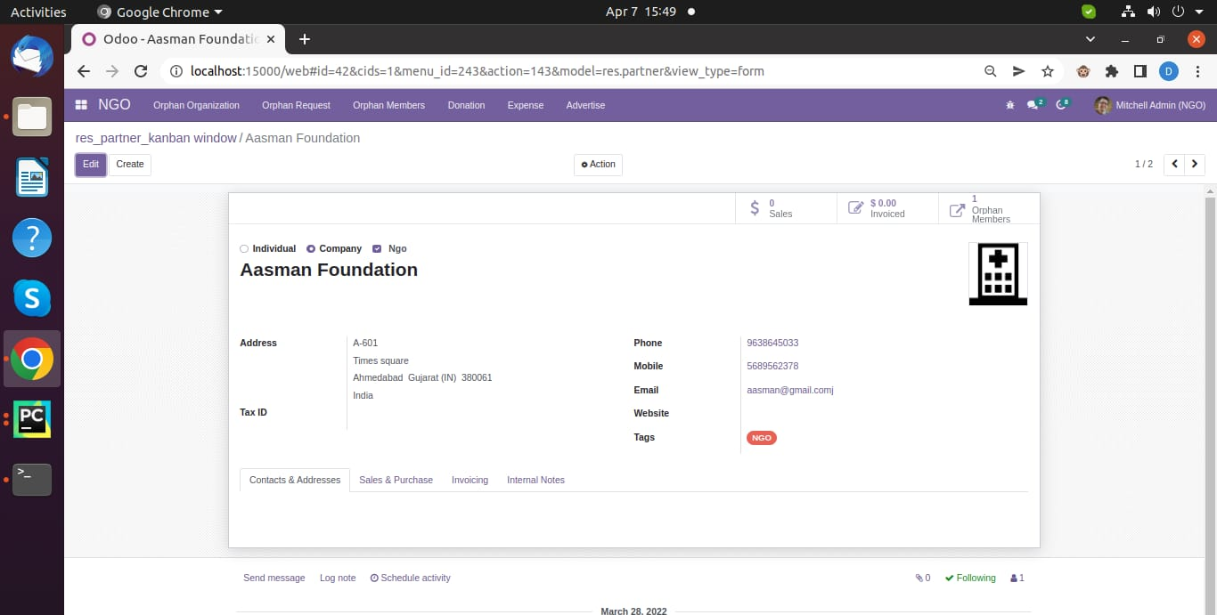
At First, we have added NGO’S which manages some orphanage.
On Clicking at the icons of NGO you will be able to see the details of NGO or Profile of NGO.

Slide 12
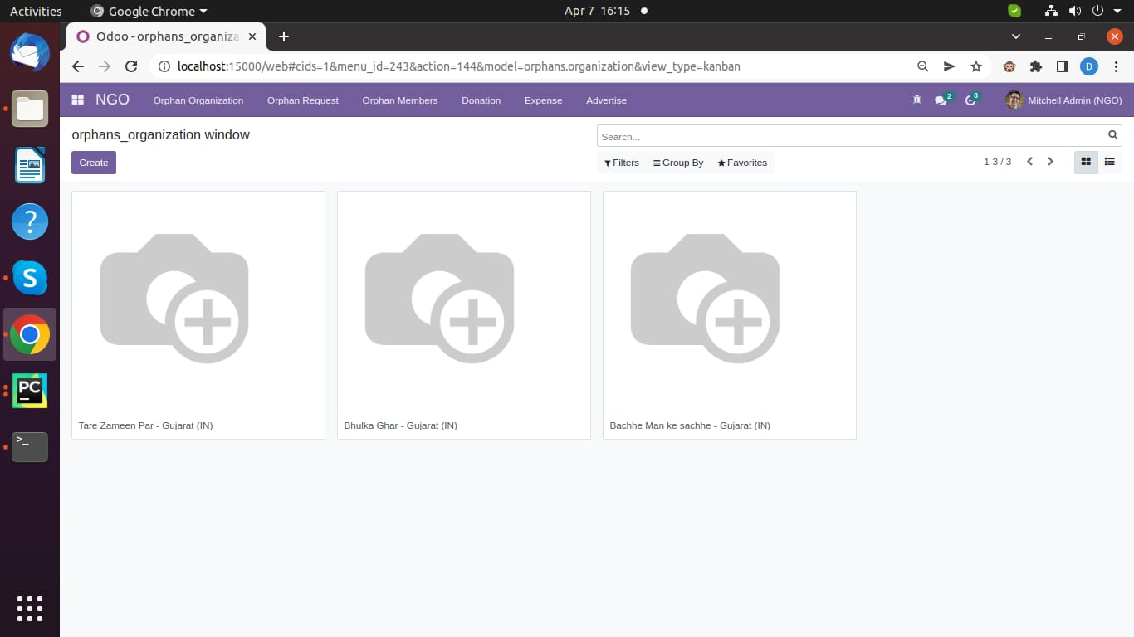
This are Orphanage which are manage by NGO’s.
On Clicking at the icons of Orphanage you will be able to see the details of Orphanage or Profile of Orphanage.

Slide 13
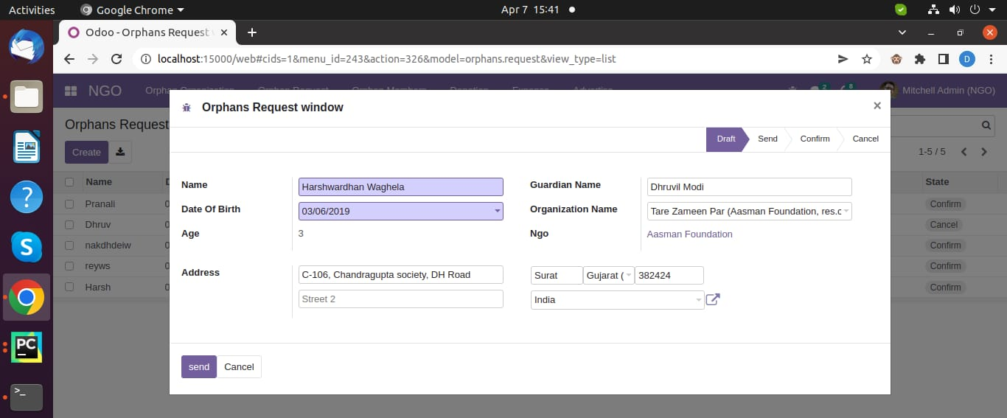
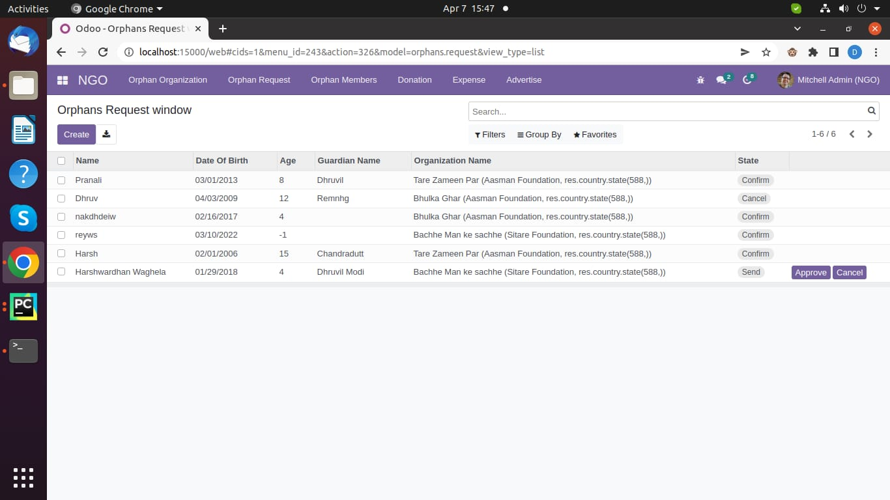
You can also give request to add member in orphanage, by clicking at top of interface on Orphanage Request.
On clicking of orphanage request you can see two option first is of to request for member to add.
And second is of to check whether the request is approved or not.

Slide 14
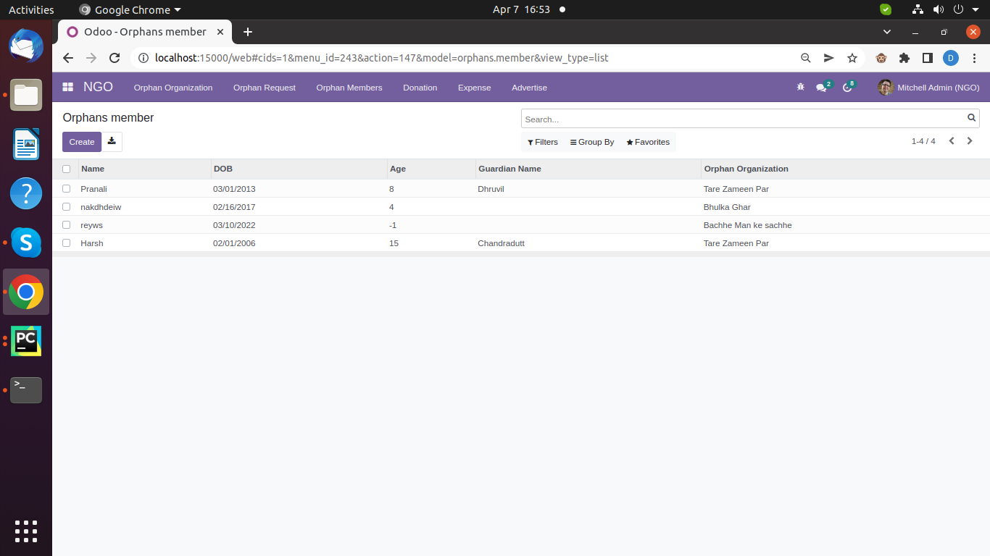
On clicking at the orphan member, it will show how many member are there in orphanage with there details and in which Orphanage.

Slide 15
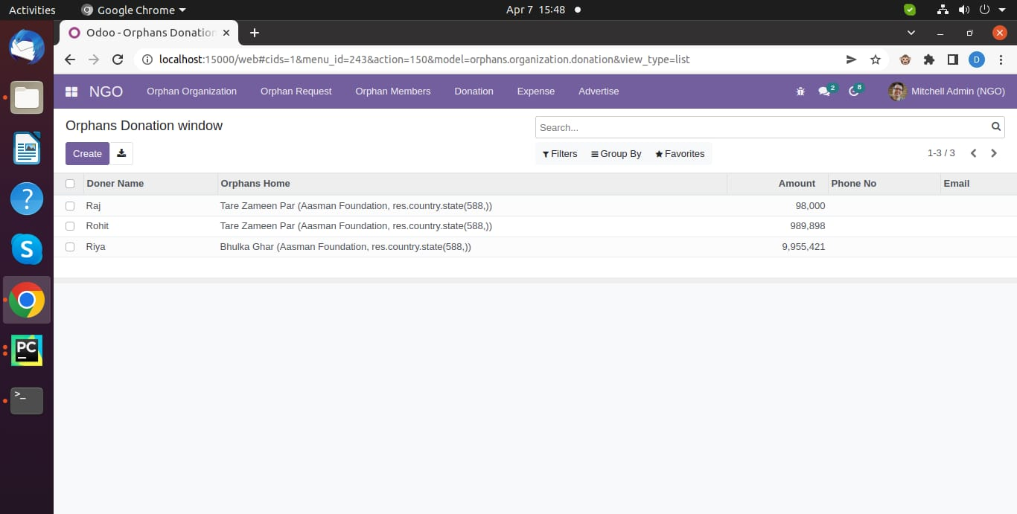
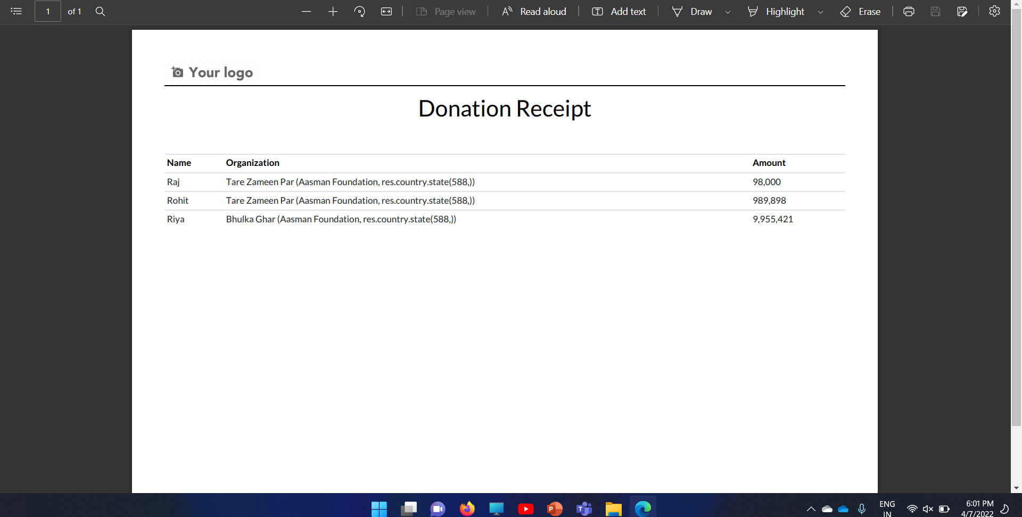
On clicking at the Donation, it will show how many people have do donation in which orphanage.
You can also download a pdf or receipt of donation on selecting and then click on print.

Slide 16
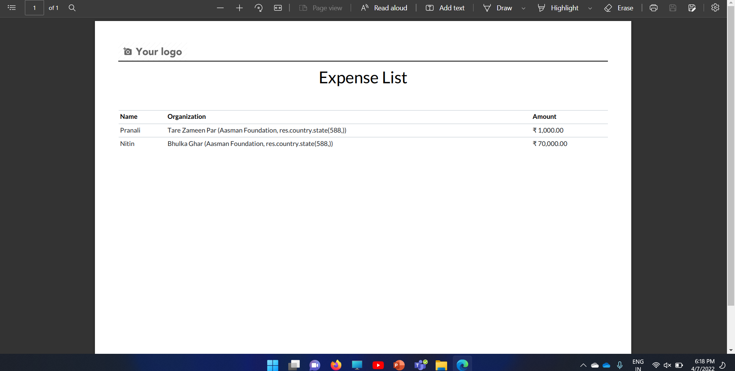
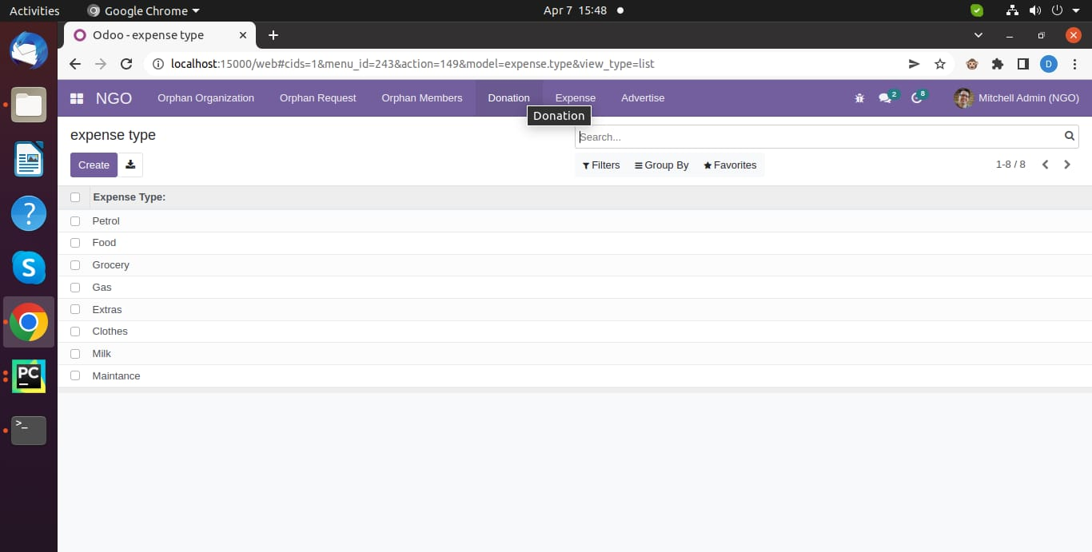
On clicking the Expense, you will get the two option of expense and expense-type.
On clicking the expense at the top of interface you can see the expenses types and expenses which are done in Orphanage.
On clicking on expense, you will be able to see expense done by members and you can also download the pdf of expense.

Slide 17
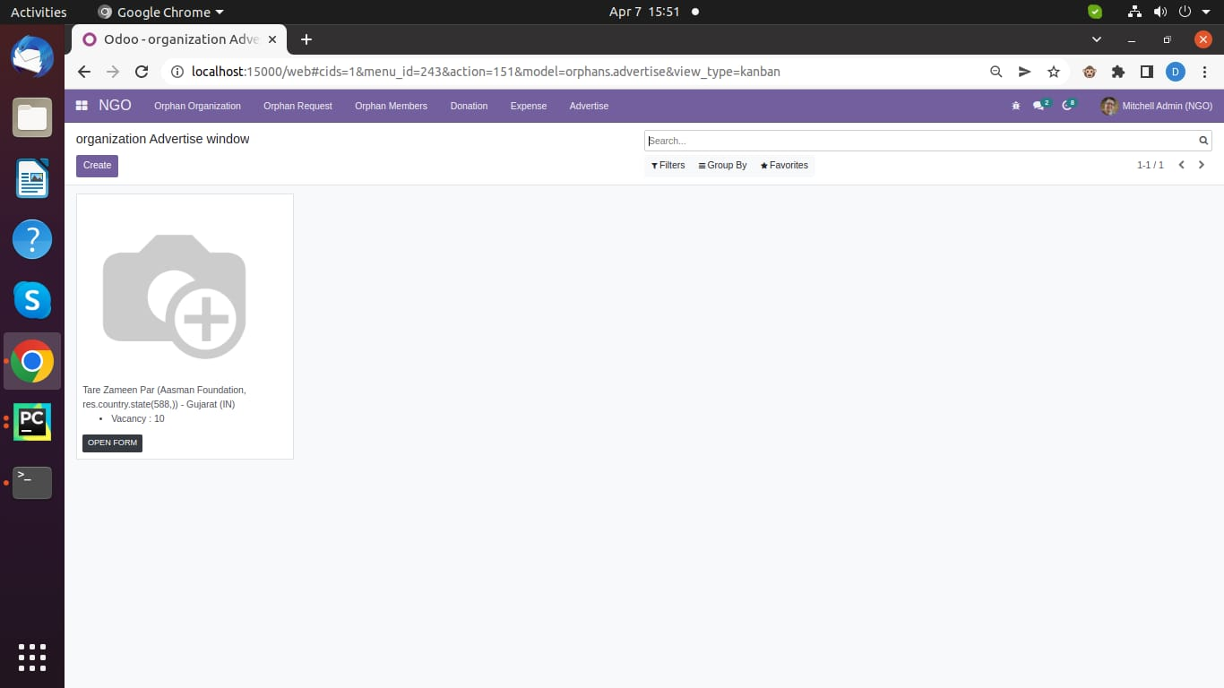
You also give and advertisement of and orphanage on clicking at the adversities.

Slide 18
THANK YOU

